Slide 1

UNIVERSITY OF BUEA FACULTY OF ENGINEERING AND TECHNOLOGY DEPARTMENT OF COMPUTER ENGINEERING LEVEL 300
SOFTWARE DEVELOPMENT TOOLS CEF 333
GROUP 1 PRESENTATION WEEK FOUR
DEMONSTRATE IDE SETUP AND DEBUGGING IN VS CODE
S/N | GROUP MEMBER | MATRICULATION NUMBER
1. | LENYA SHAMPEL LENYA | FE23A001
2. | ACHUO PLACID ACHUO-ASSAM | FE23A004
3. | AFUH CHIKE CHEWAKONDI | FE23A005
4. | AGBORNJA BESONG AKPAK DIVINE | FE23A006
5. | AKOH JUNIOR NGOH | FE23A008
COURSE FACILITATOR: DR. NKEMENI Valery
COURSE FACILITATOR: DR. NKEMENI Valery

Slide 2
Microsoft Visual Studio Code
Description
It is a free, powerful, lightweight code editor which runs on the Windows, MacOS and Linux operating sytems
It is highly customizable with over 25000 extensions, for every programming language

Slide 3
Key features of the VS Code IDE
It offers a rich support for a large set of languages. This is achieved through the addition of languages as extensions
Tuning your settings: Most aspects of VS Code can be customized to your liking.
Quick navigation between files

Slide 4
Setting up VS Code on your PC
This was done by all members of the group

Slide 5
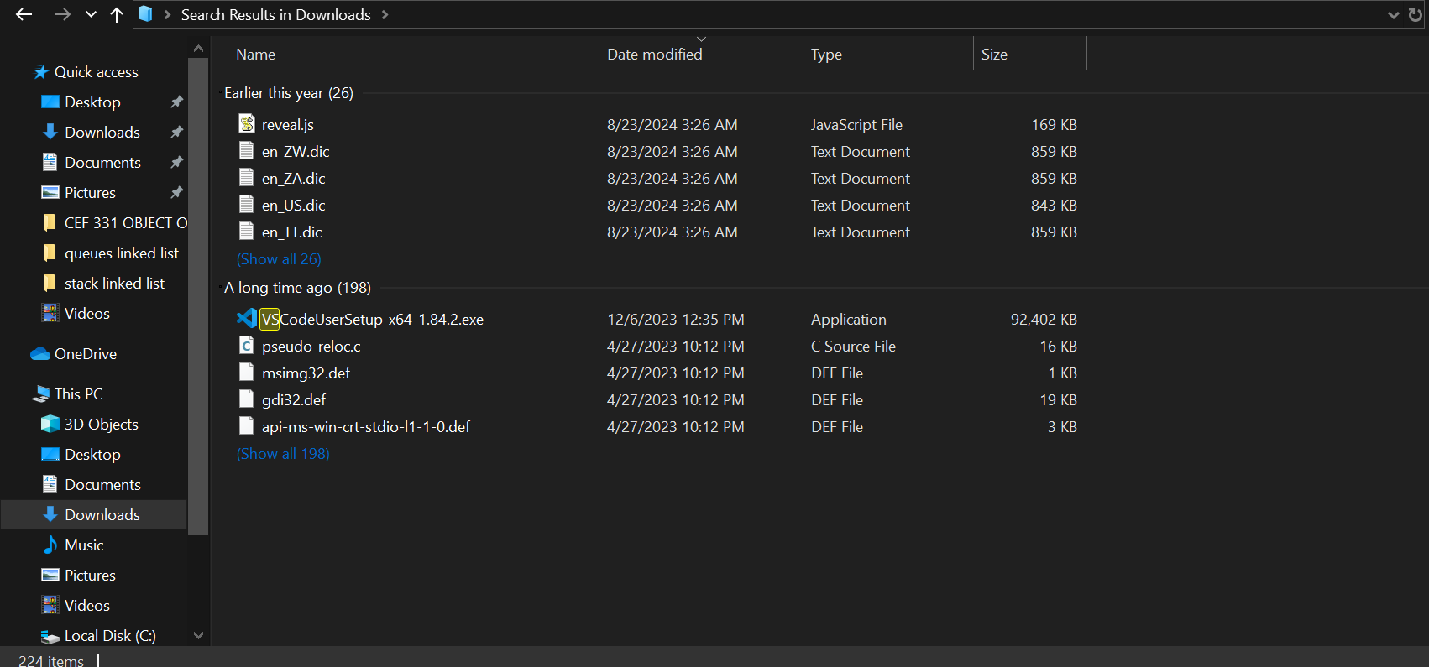
1.Download the visual Studio Code installer

Slide 6
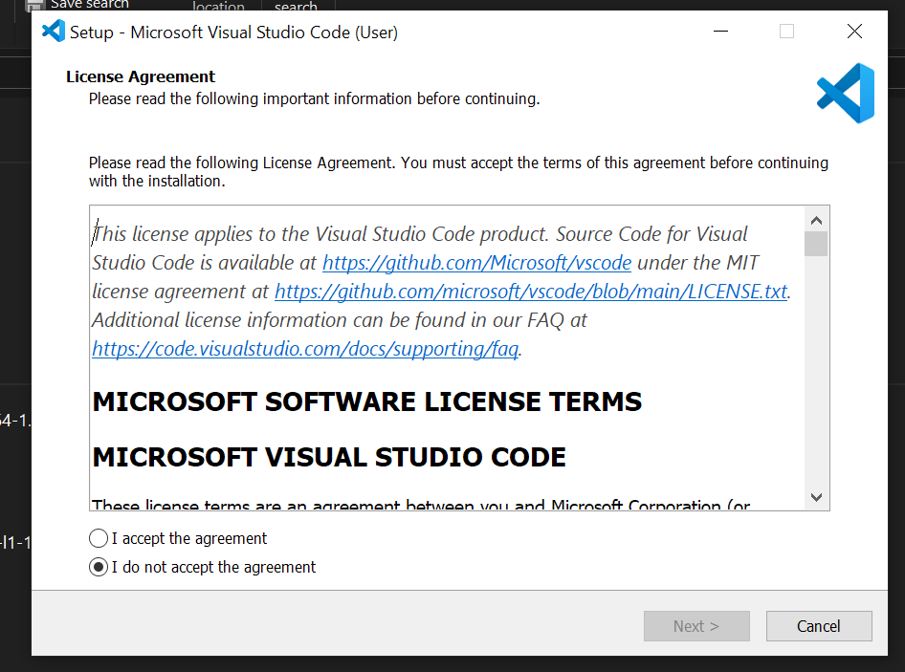
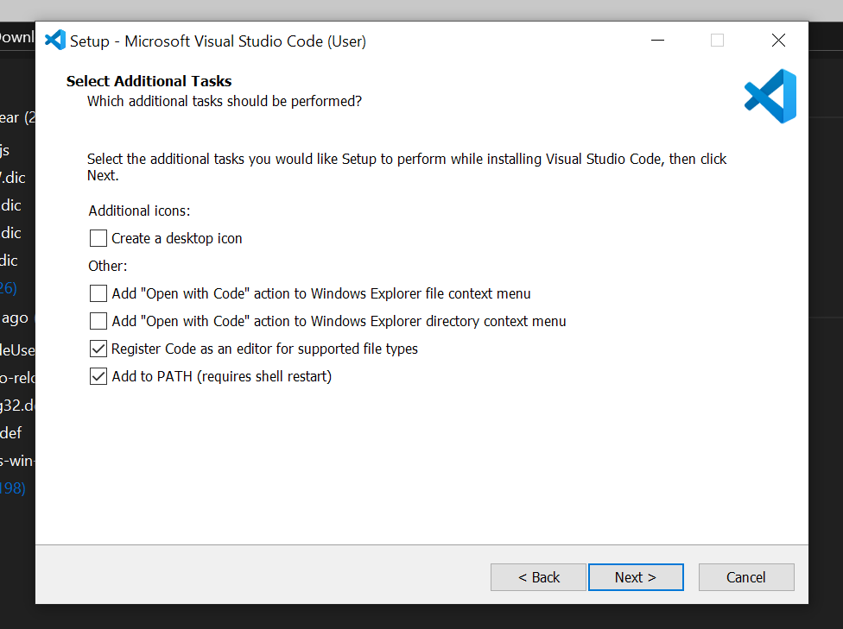
2.Run the installer

Slide 7
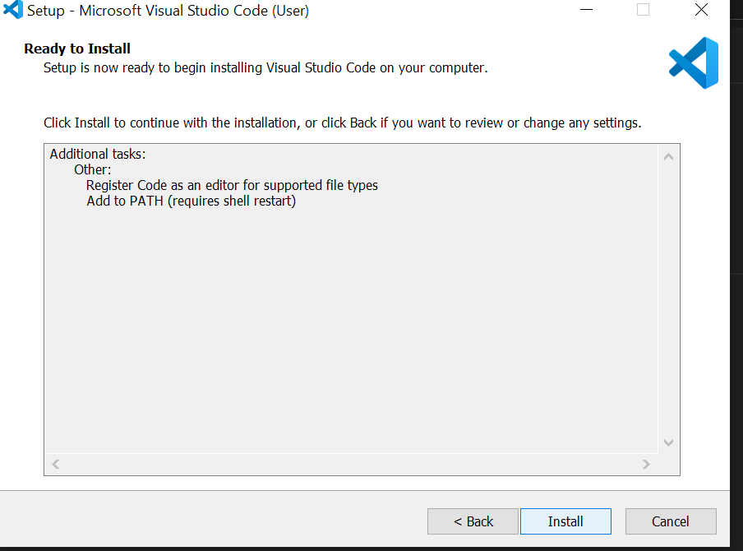
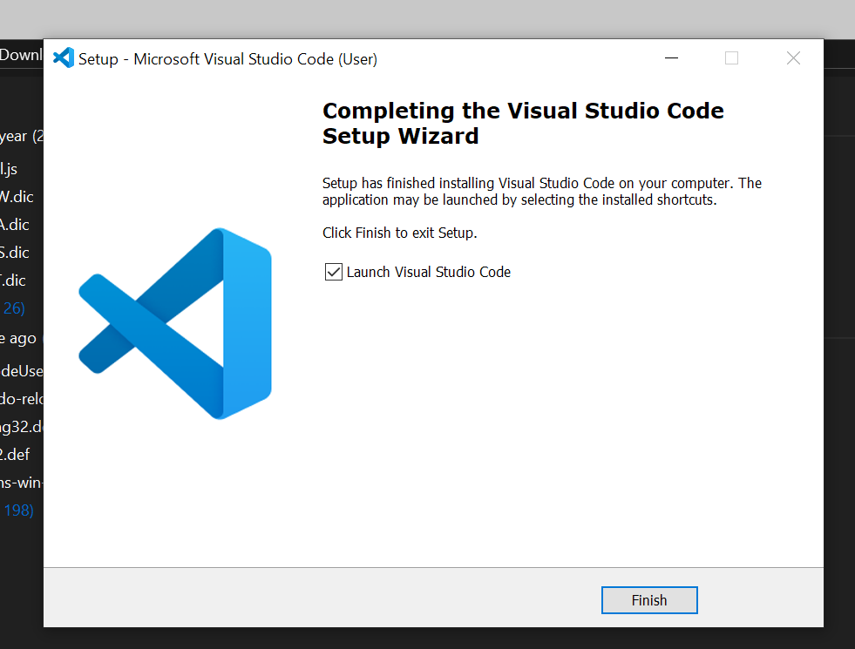
Launch

Slide 8
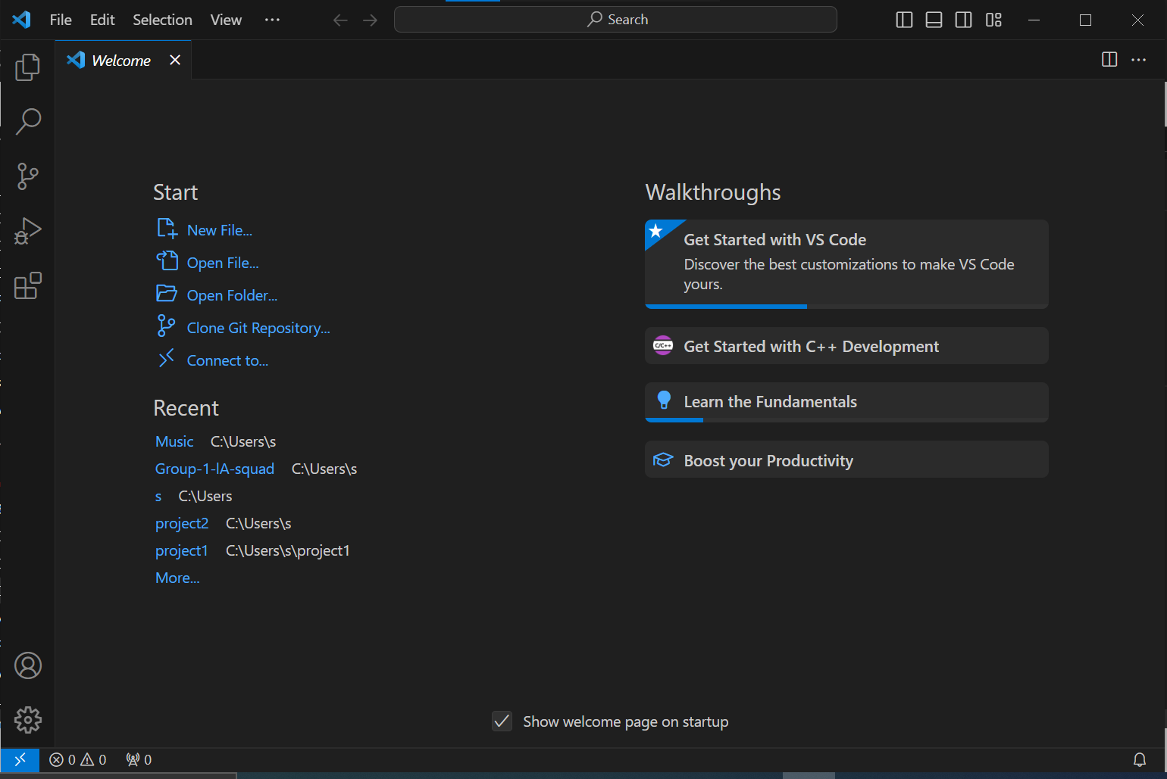
There you go

Slide 9
Description of the editor (User Interface)

Slide 10
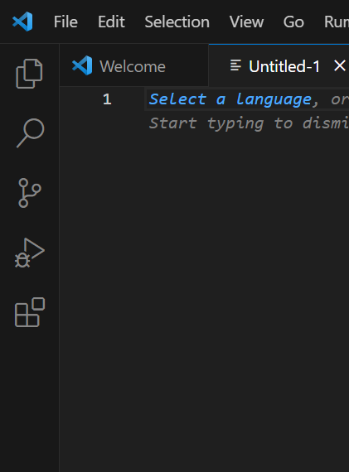
The activity bar
On the left of your code page is the activity bar which comprises of some icons
- The file button: To see your folders and files
The search option: To find and replace text in files or across your whole code
Source control: To track changes in code with Git and GitHub
Run and Debug: To run and execute code using breakpoints
Extensions: To add extensions and features to our editor

Slide 11
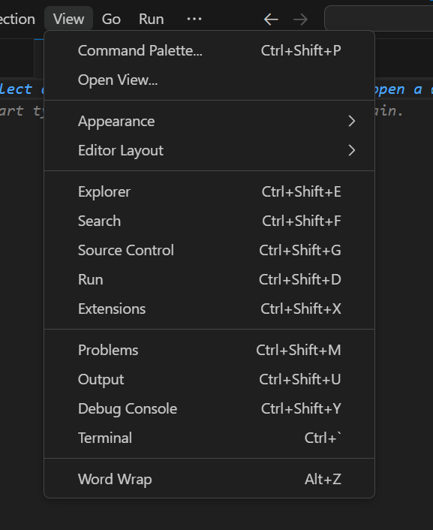
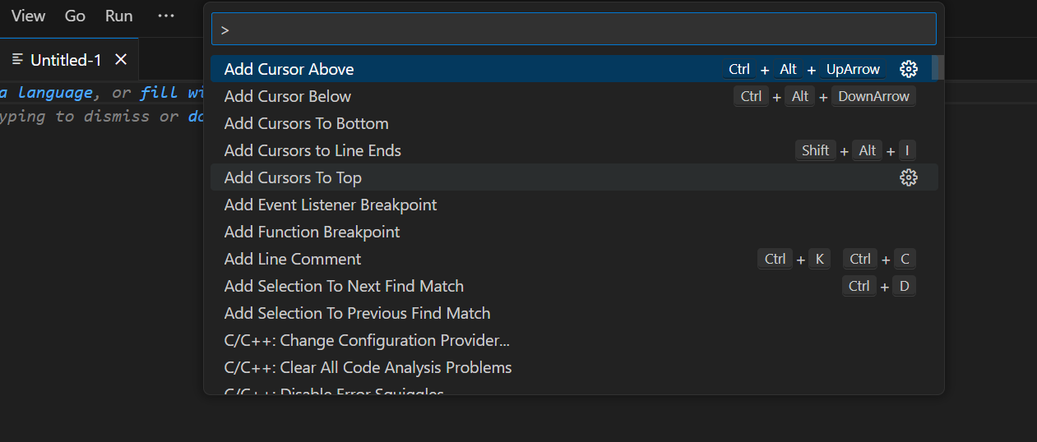
In the top ribbon, you could also find the command pallet
By choosing the tab view then command pallet: You have access to the command pallet
- The command pallete is very important. It is the control center for any command in visual studio code

Slide 12

The status bar
Left icons indicate warnings and errors in code while the right side of the bar indicates the line data of the code and the language in which the code is being written in

Slide 13
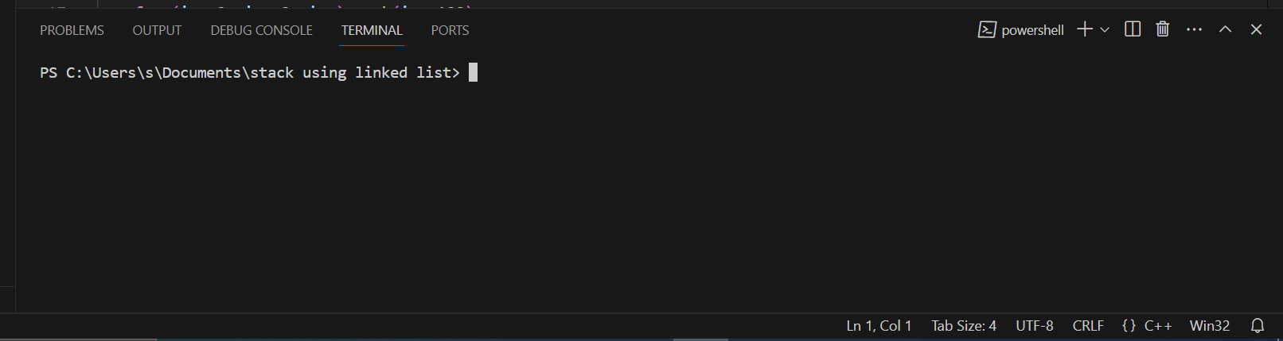
Output panel
The output panel can be accessed from the top horizontal bar,
It shows output, bugs in an in-built terminal

Slide 14
Extensions
These are downloadable features of VS Code that let you add support and features to VS code to favour development
The extension being downloaded in this case is the python extension
To go about this,

Slide 15
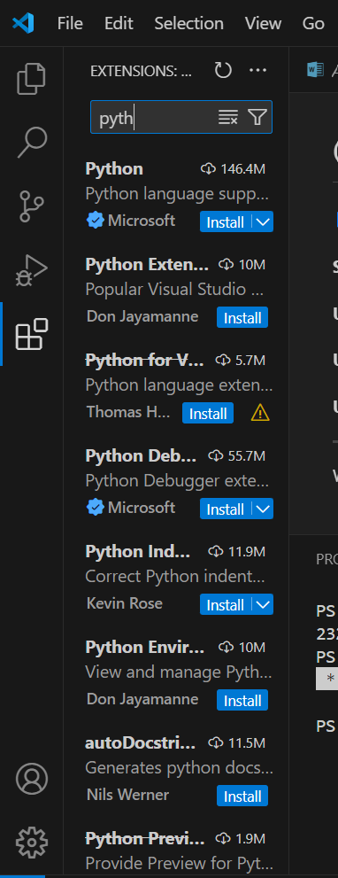
Browse for extensions: We choose the extensions button from the activity bar
This will show a list of the most popular vs code extensions from the extensions market place
Some characterizing information for the extensions are authors, name, published date and others

Slide 16
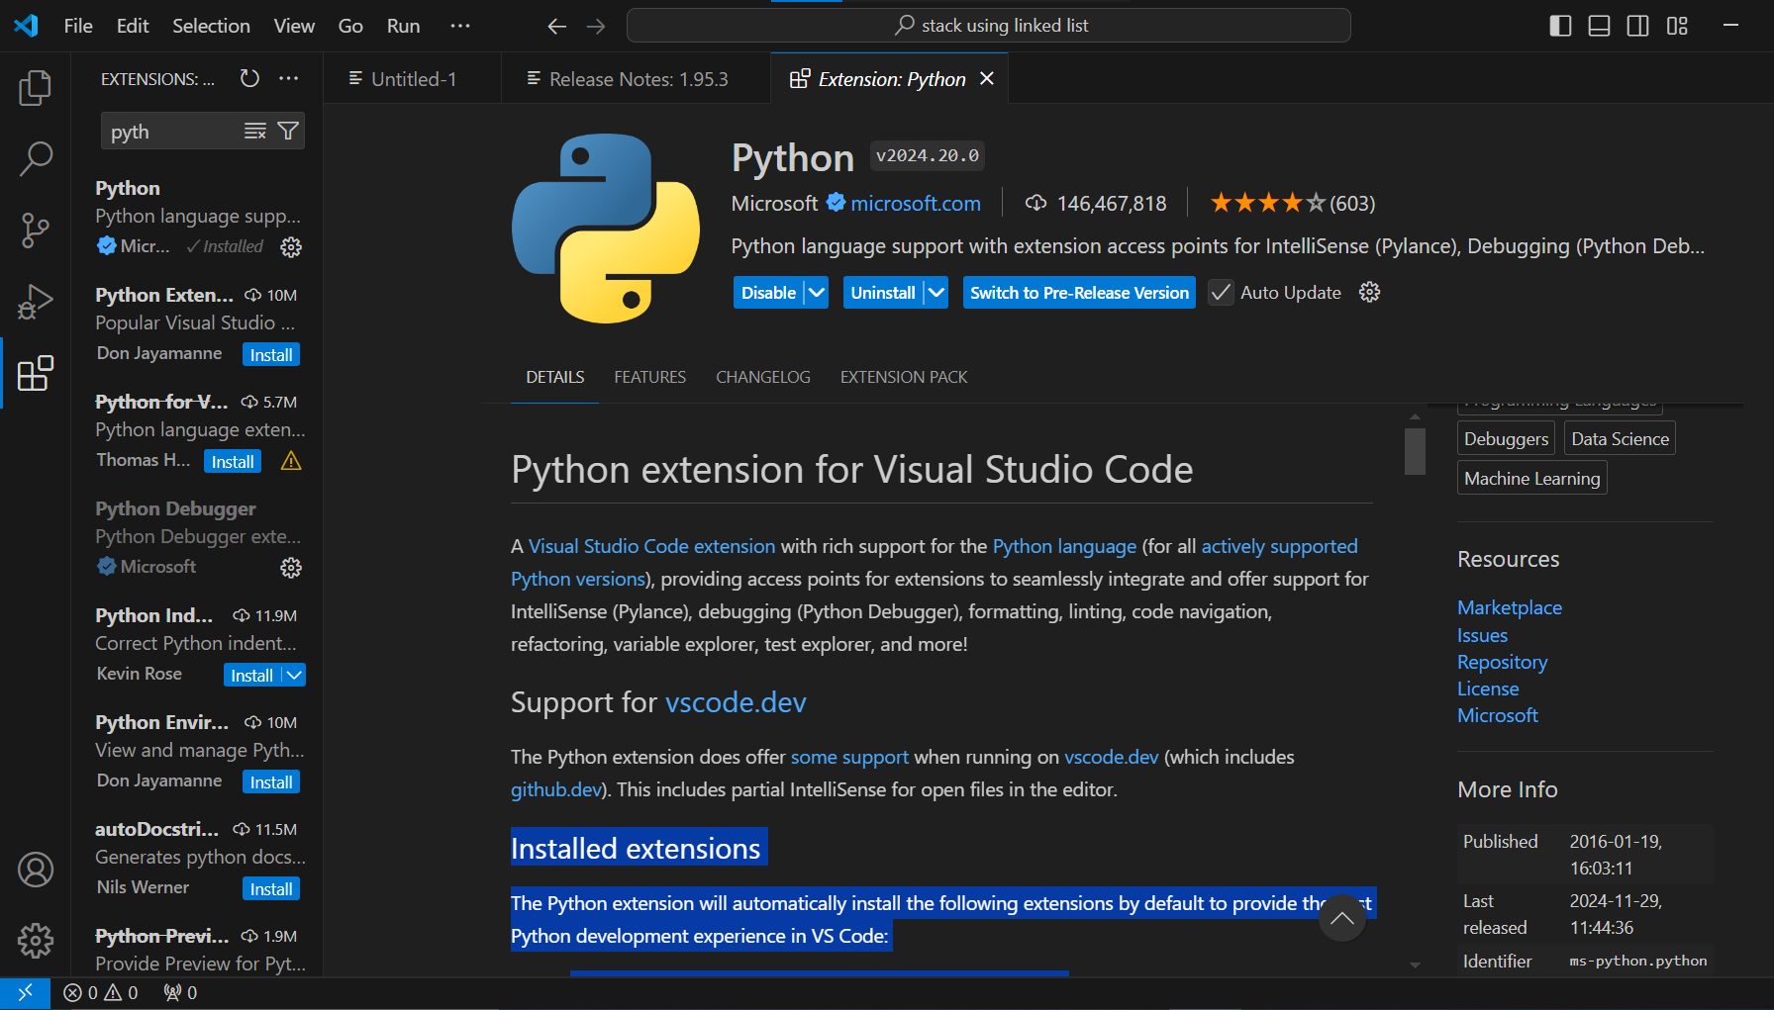
Install an extension: select the install button. Once the installation is complete, the install button becomes the manage button which can lead you to more managing features

Slide 17
Extensions obtained
Python extension
Author: Microsoft
Comprising of the following Installed extensions
Pylance - to provide performant Python language support
Python Debugger - to provide a seamless debug experience with debugpy

Slide 18
Debugging

Slide 19
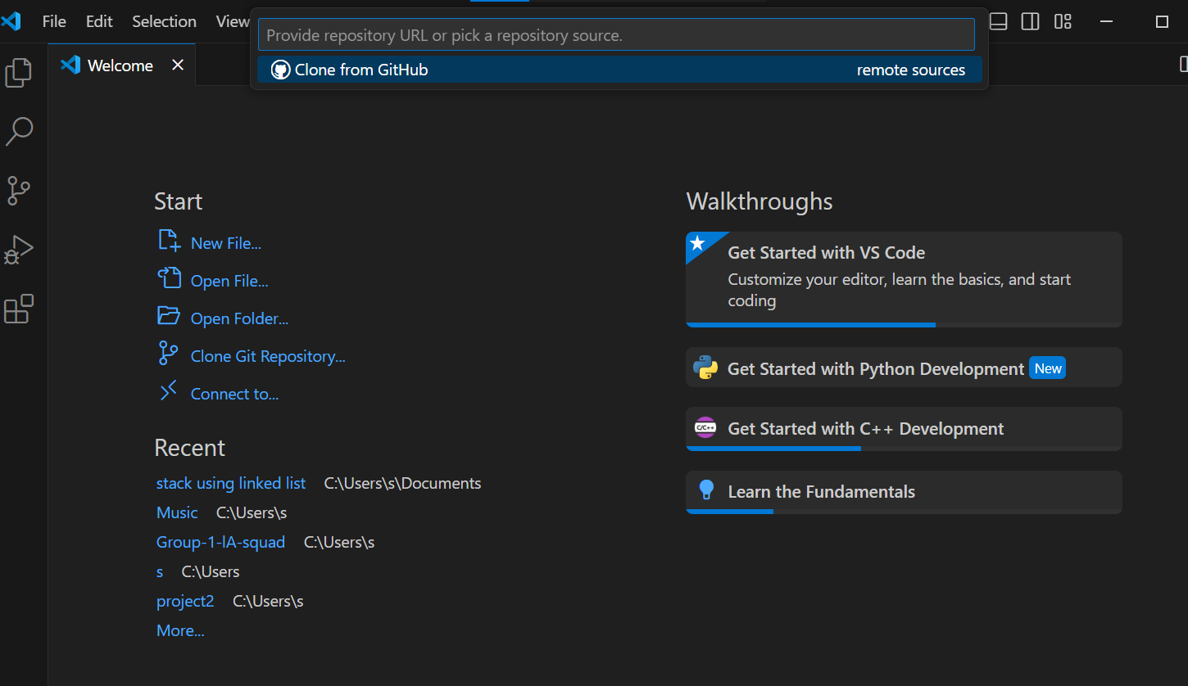
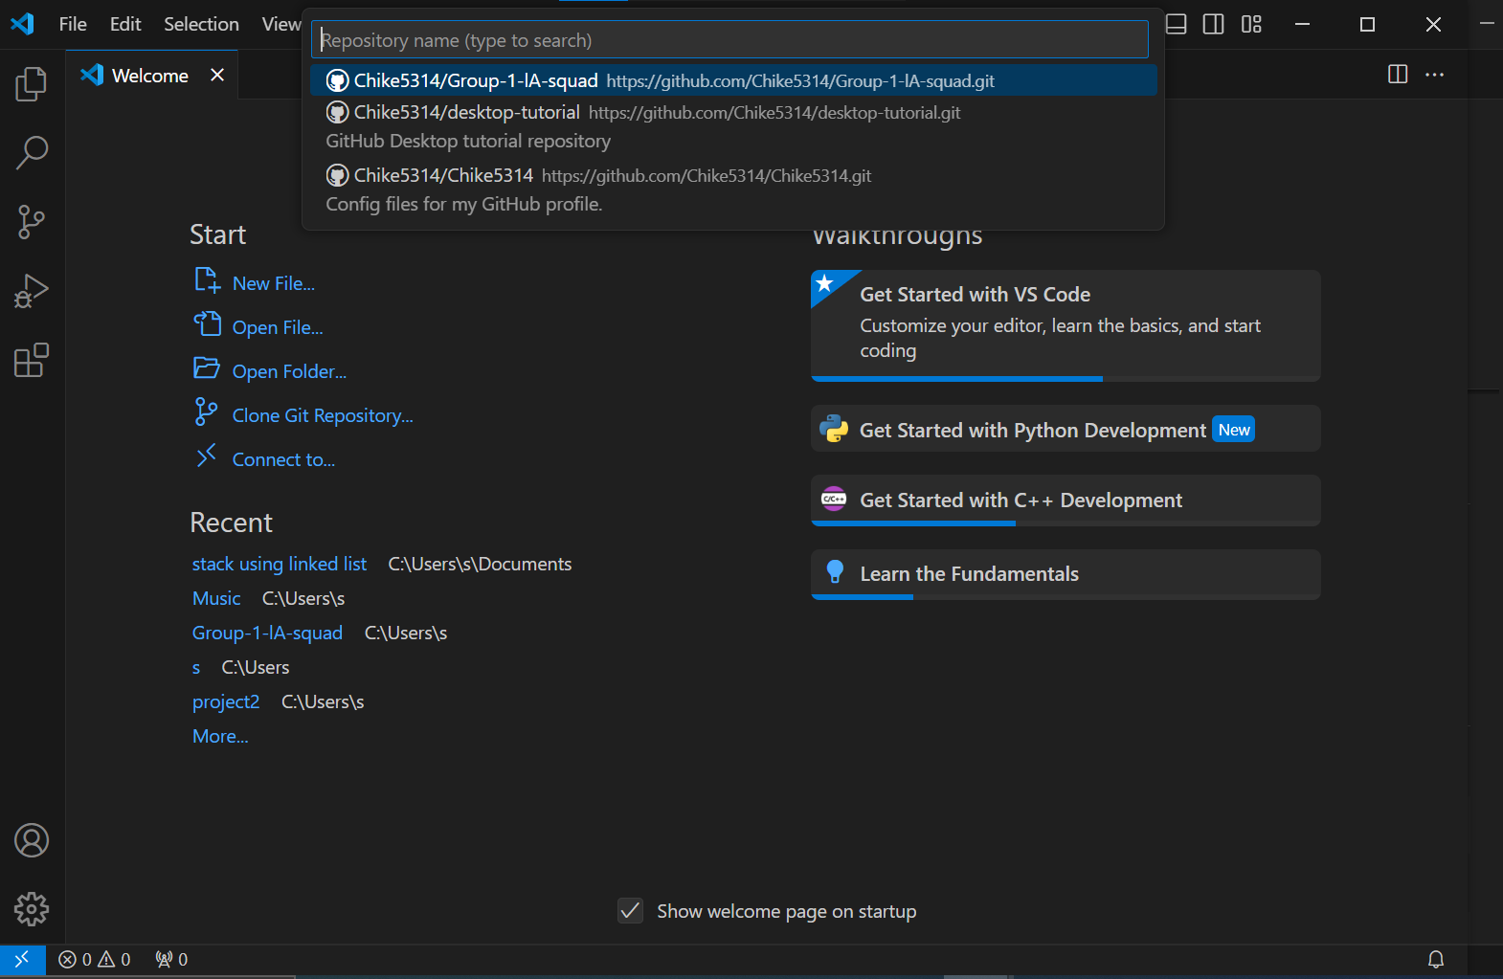
After installing the extension, our vs code will now be able to edit and debug our python code effectively. First, we need to obtain the code from GitHub
This is done directly on vs code
You have the option to clone the repository, select where to store it in your local pc and open it and start editing

Slide 20
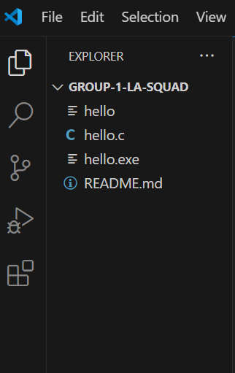
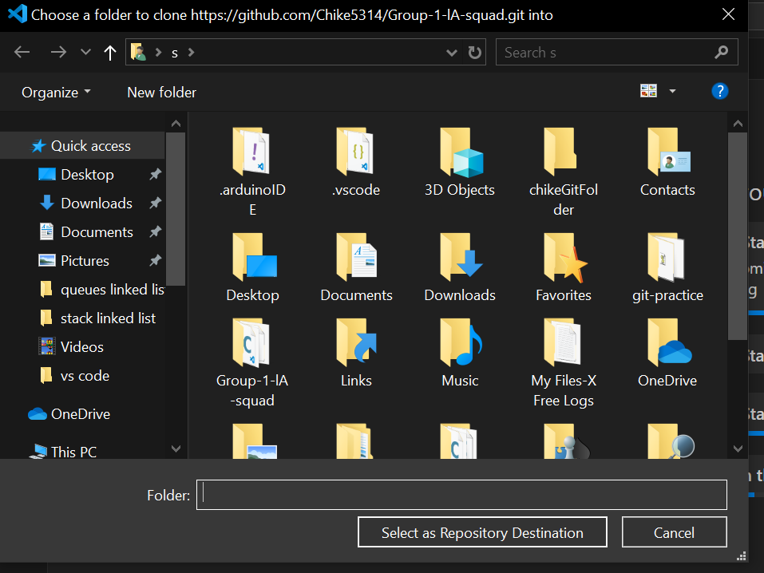

Slide 21
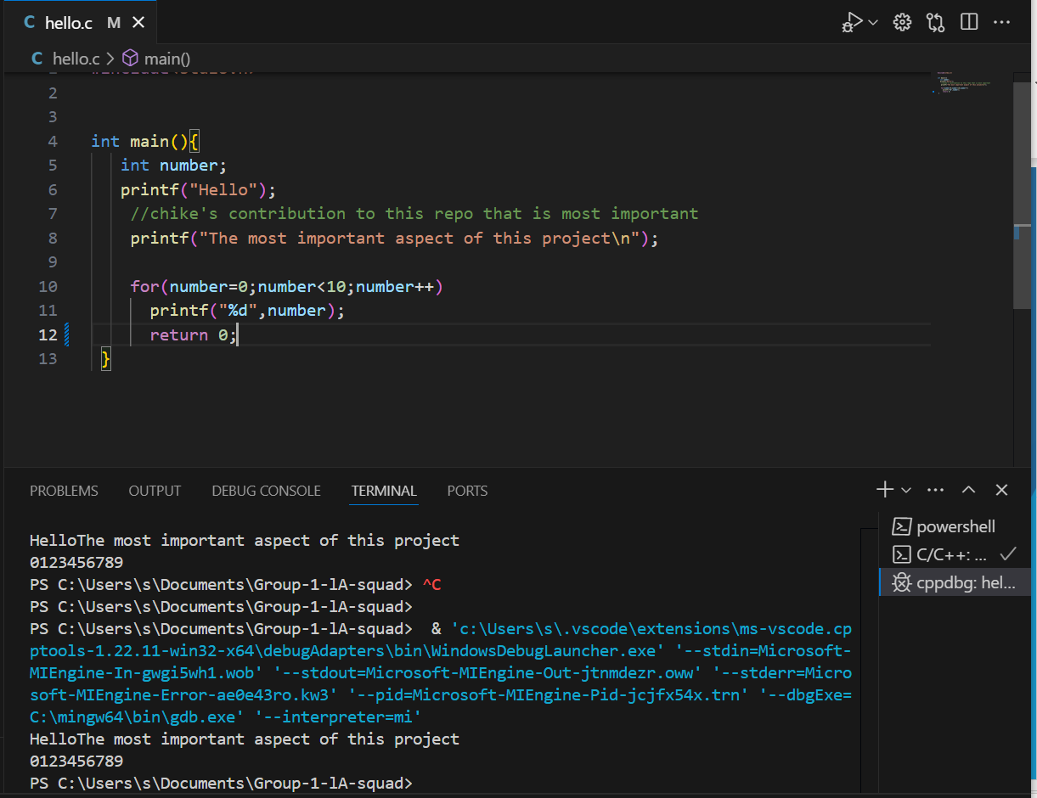
Debugging mostly happens in the output panel in VS Code. It contains provides output to the code run, the debug console and the terminal
Sample Usage

